Slide 1

Module 10: Time series
DS 522 Data Acquisition and Analytics

Slide 2
AGENDA
Date and Time
Time Series Basics
Date Ranges, Frequencies, Shifting
Resampling and Frequency Conversion
Moving Window

Slide 3
Date and time data types and tools

Slide 4
Time series data Types
Time series data
Anything that is recorded repeatedly at many points in time.
Important structured data in many different fields
finance, economics, ecology, neuroscience, and physics
Needs different types of analysis and transformation tools
Types:
fixed frequency - data points occur at regular intervals (e.g. every 15 sec, every 5 min, or monthly
irregular - without a fixed unit of time or offset between units.

Slide 5
Time series data types
How to mark and refer to time series data:
Timestamps - Specific instants in time.
Fixed periods - Such as the whole month of January 2017, or the whole year 2020.
Intervals of time - Indicated by a start and end timestamp. Periods can be thought of as special cases of intervals.
Experiment or elapsed time - Each timestamp is a measure of time relative to a particular start time starting from 0.

Slide 6
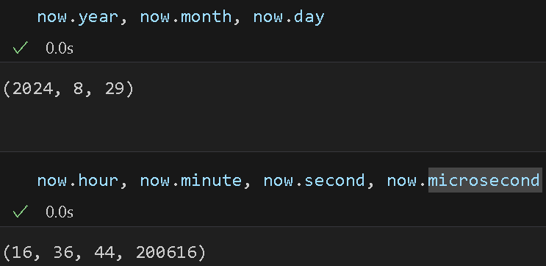
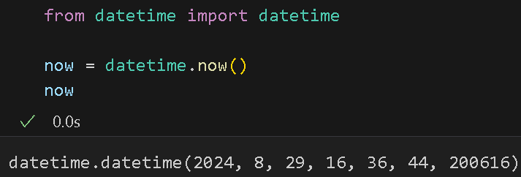
Python & Pandas built-in time series tool
datetime library – widely used
datetime.datetime module stores both date & time
Date: year, month, day
Time: hour, minute, second, microsecond
Examples:

Slide 7
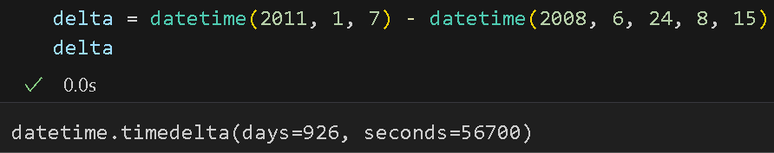
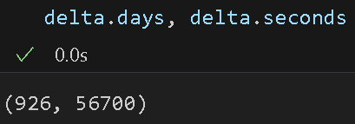
Python & Pandas built-in time series tool
Datetime.timedelta module – represents the temporal difference between 2 datetime object.
Timedelta allows operations to datetime object: add, subtract, multiply
Examples:

Slide 8
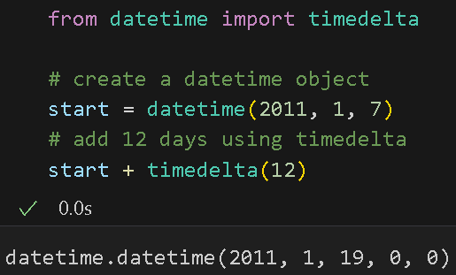
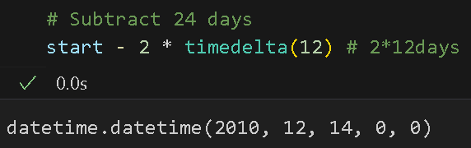
Python & Pandas built-in time series tool
Datetime.timedelta operations yields a new shifted object
Examples:

Slide 9
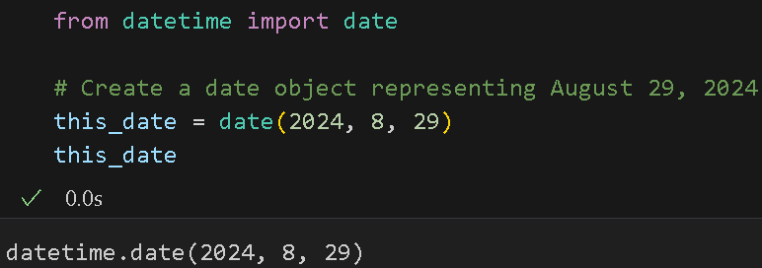
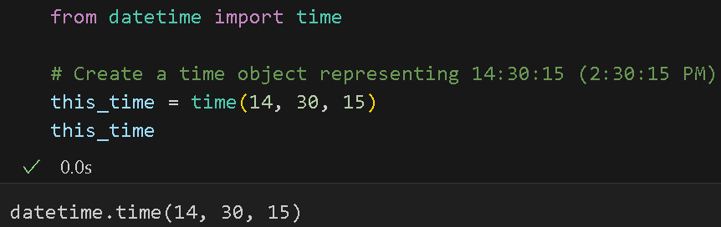
Python & Pandas built-in time series tool
datetime.date – stores calendar date (year, month, day)
datetime.time – stores time of the day (hours, minutes, seconds, microseconds)
Examples:

Slide 10
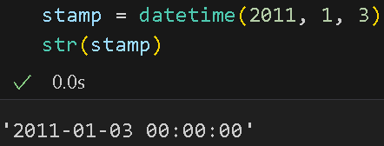
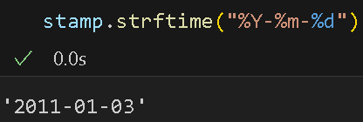
Converting between string and datetime
str or strftime – formats datetime & Pandas Timestamp objects to strings
Examples: datetime to string
%Y = 4-digit year
%y = 2-digit year
%m = 2-digit month
%d = 2-digit day
%H = Hour (24-hour clock) [00, 23]
%I = Hour (12-hour clock) [01, 12]
%M = Two-digit minute [00, 59]
%S = Second [00, 61]
%F = Shortcut for %Y-%m=%d
%f = Shortcut for %m/%d/%y
%j = Day of the year (001 t0 336
%u = Weekday as an integer starting from 1, where 1 is Monday

Slide 11
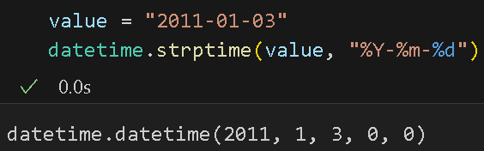
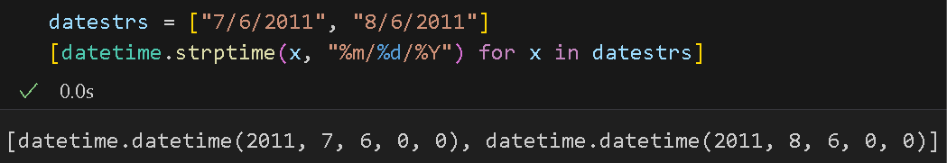
Converting between string and datetime
str or strftime – formats datetime & Pandas Timestamp objects to strings
Examples: string to datetime

Slide 12
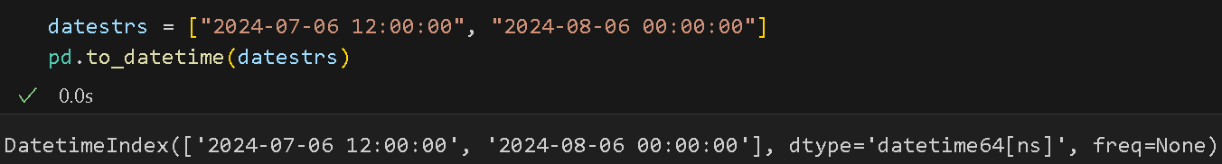
Converting between string and datetime
datetime.strftime or pandas.to_datetime – parse dates to known date formats
Parsing dates - EXTREMELY important when dealing with time series data
Examples: date to ISO 8601 format

Slide 13
PANDAS Time series basics

Slide 14
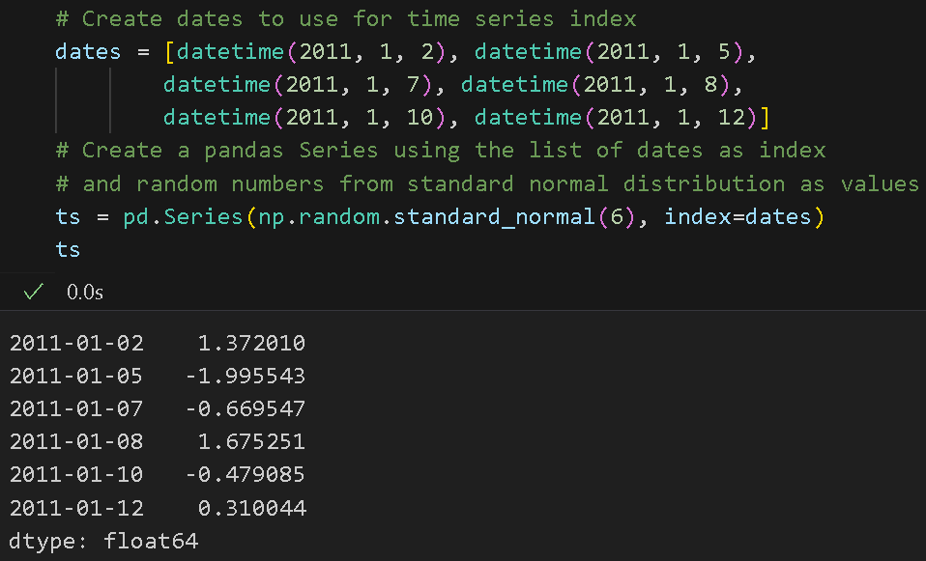
Time Series Basics: Pandas Series
pandas.Series
– basic kind of time series object
- indexed by timestamps
- often represented outside of pandas as Python strings or datetime objects.

Slide 15
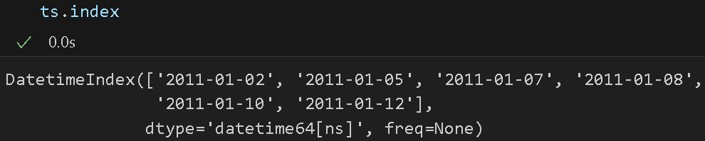
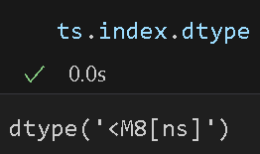
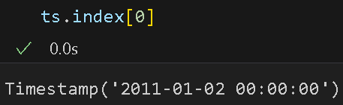
Pandas Series and timestamps
Datetime object used as indices are parsed to DatetimeIndex automatically.
Timestamps - NumPy datetime64 datatype (nanosecond level).
Timestamp objects – the scalar values from a DatetimeIndex

Slide 16
Pandas Series and timestamps
pandas.Timestamps VS
can generally substitute datetime.datetime object.
designed to be compatible with datetime.
more capabilities, features
Nanosecond precision
With frequency information useful for time series analysis
Supports time zone conversion
Works seamlessly with Pandas’ time series manipulation tools (resampling, shifting, rolling computations
datetime.datetime
can’t fully substitute pandas.Timestamps
Lacks some capabilities and features that pandas.Timestamps have
More limited
Microsecond precision – can’t handle finer precision

Slide 17
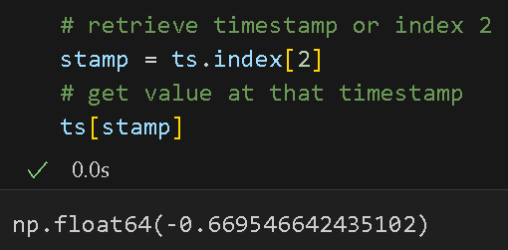
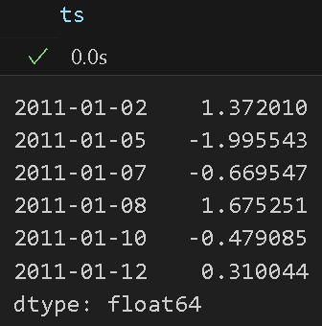
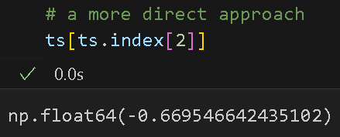
Indexing, selection, subsetting
Time Series indexing and selecting data – process is like the other Series
Example:

Slide 18
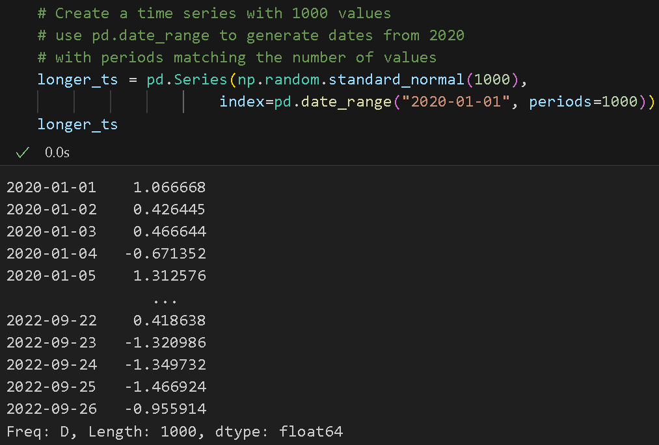
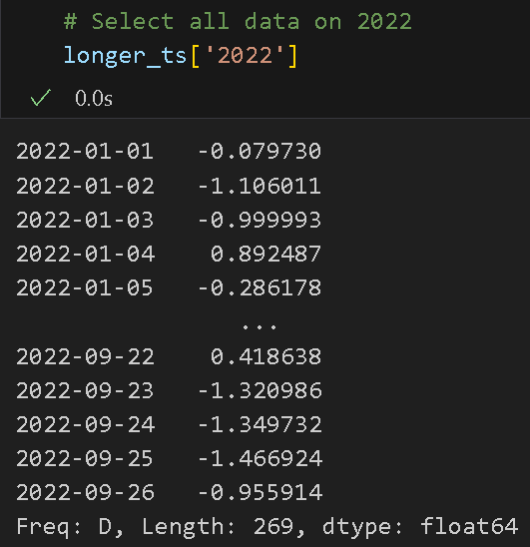
Indexing, selection, subsetting
Time Series indexing and selecting data (continue)
Example: Use a longer time series generated using pd.date_range and np.random number generator and slicing with a string format of dates.

Slide 19
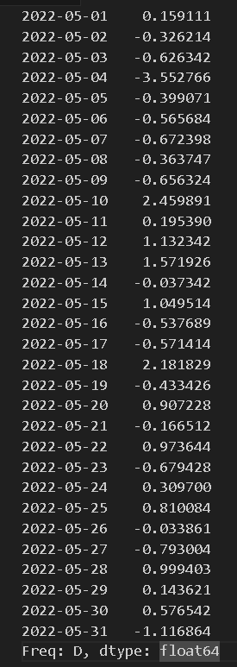
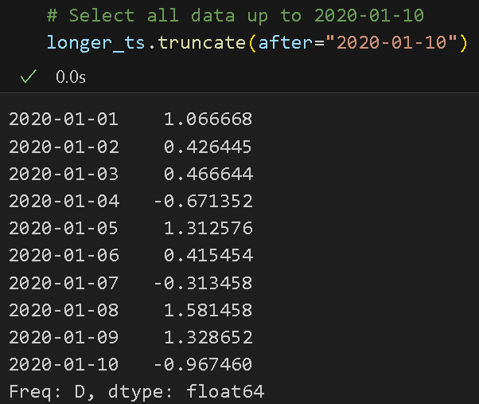
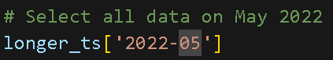
Indexing, selection, subsetting
Time Series indexing and selecting data (continue)
Example (continue): Slicing with a string format of dates

Slide 20
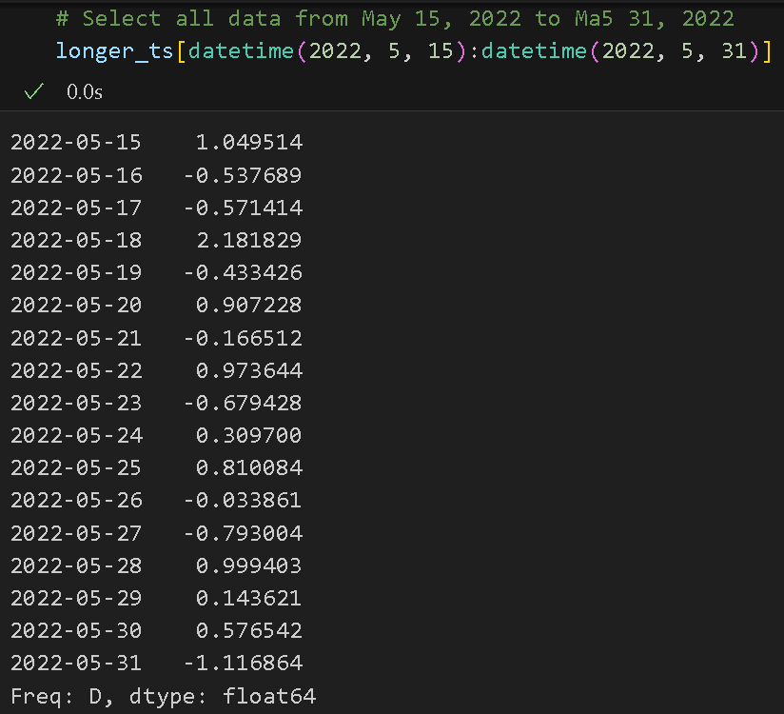
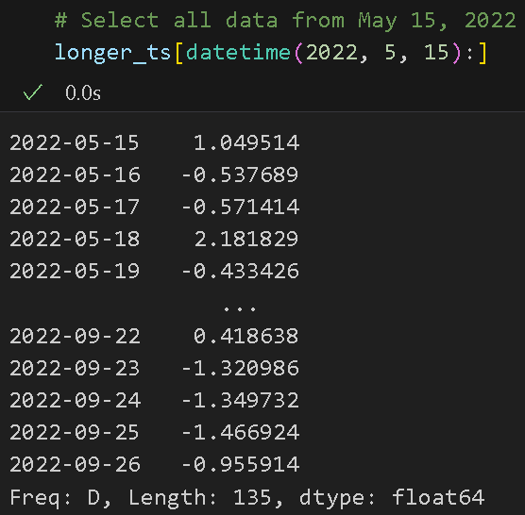
Indexing, selection, subsetting
Time Series indexing and selecting data (continue)
Example (continue):
Slicing with datetime format

Slide 21
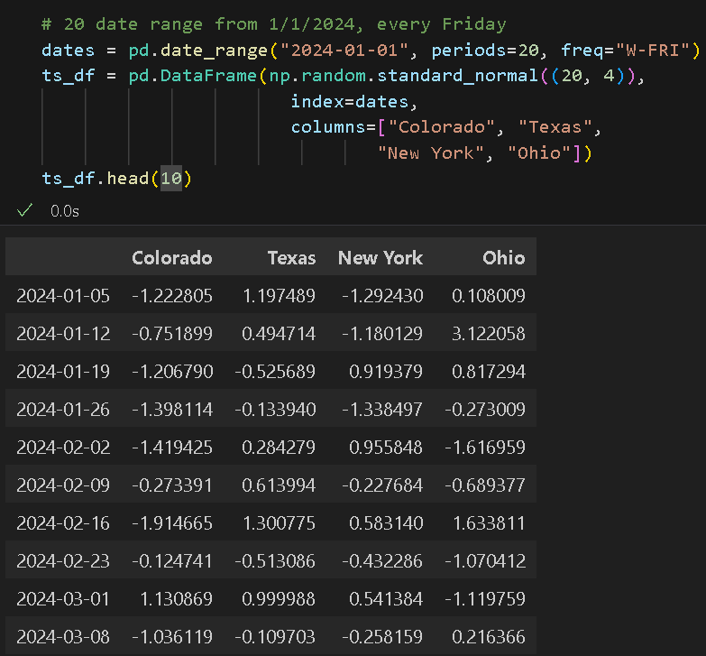
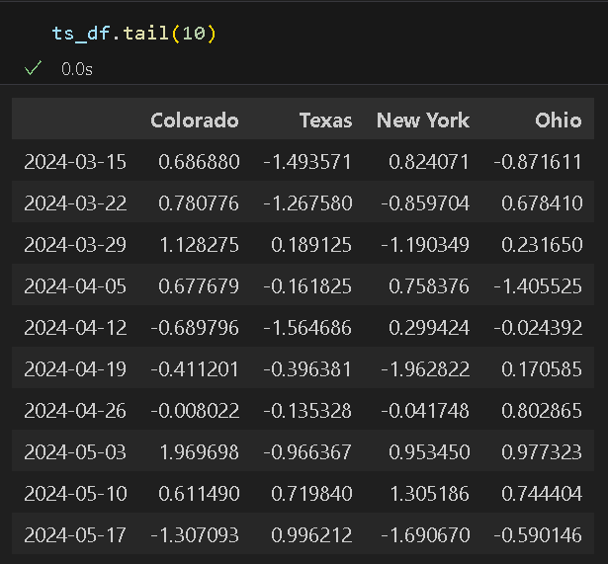
Indexing, selection, subsetting
Time Series indexing and selecting data in DataFrame:

Slide 22
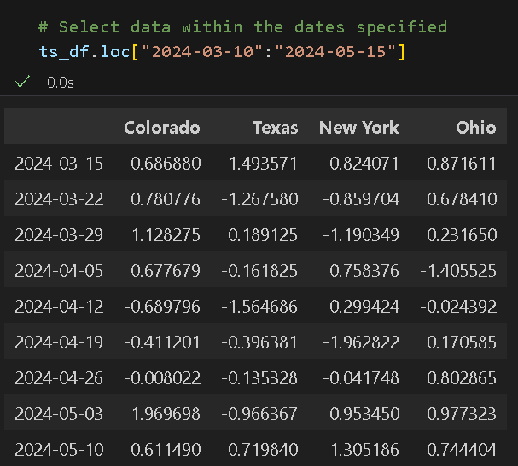
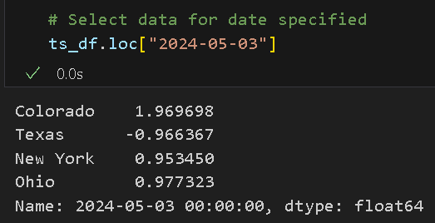
Indexing, selection, subsetting
Time Series indexing and selecting data in DataFrame:

Slide 23
Date ranges, frequencies, shifting

Slide 24
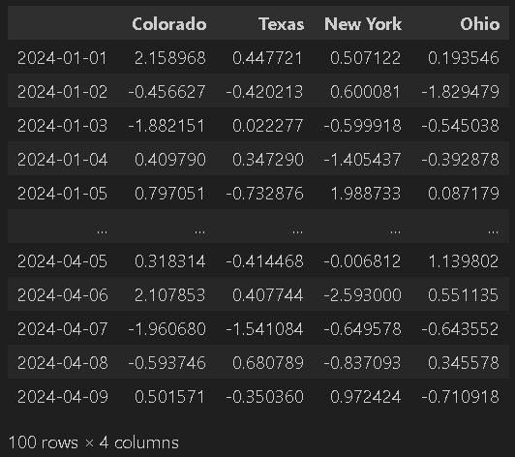
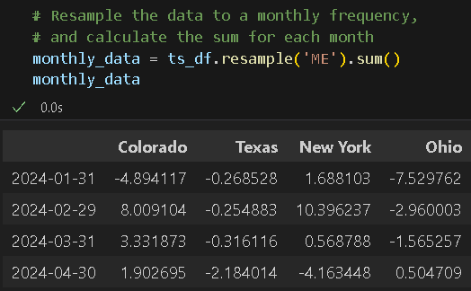
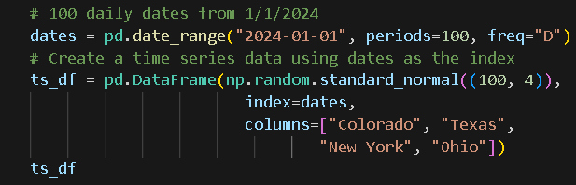
frequencies
Time Series data - irregular and no fixed frequency
Pandas provide a suite of time series frequencies and resampling tools for inferring frequencies and generating fixed-frequency date ranges.
resample() – aggregates and converts time series date to a fixed frequency
- creates a DatetimeIndexResampler object; use with aggregate functions.
Example:

Slide 25
Generating Date ranges
b. date_range() – generates a DatetimeIndex with an indicated length and frequency
- default frequency: daily
- pass a number for the ‘periods’ argument when only passing a start date or an end date
Example:

Slide 26
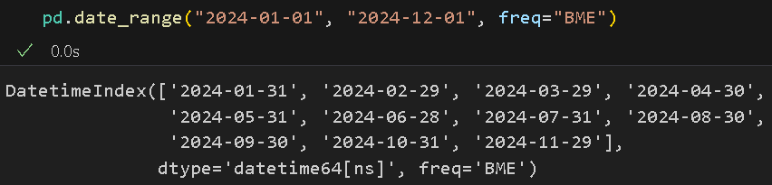
Generating Date ranges
b. date_range() – (continue)
- passing start and end dates defines strict boundaries for the generated date index
Example: Date index with last business day of each month - yields dates falling on or inside the date interval.
Note: Refer to Table 11-4 of textbook for more time series frequencies.

Slide 27
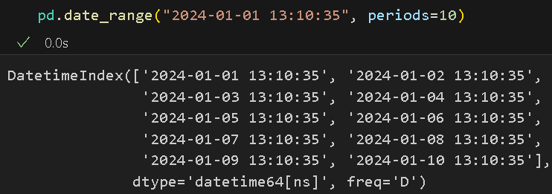
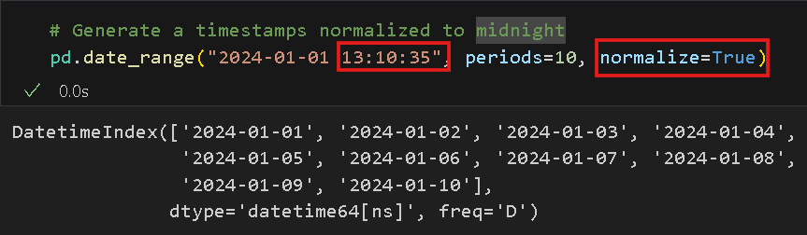
Generating Date ranges
b. date_range() – (continue)
- by default, it preserves the time if the start or end timestamp if provided.
Example:

Slide 28
Generating Date ranges
b. date_range() – (continue)
- by default, it preserves the time if the start or end timestamp if provided.
Example:

Slide 29
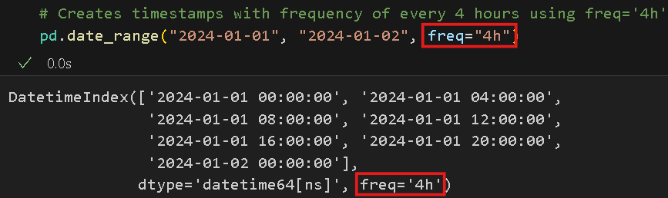
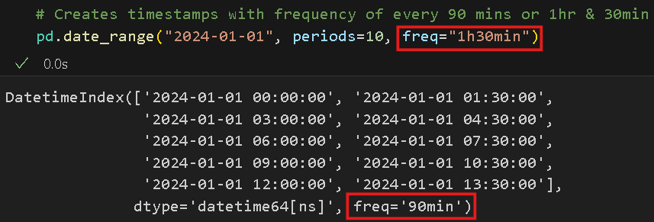
Frequencies and date offsets
c. Base frequency and a multiplier:
- string alias and a date offset as multiplier.
Example:
Hour as base frequency and 4 as the multiplier
Combined frequency and multiplier
Note: Refer to Table 11-4 of textbook for more time series frequencies.

Slide 30
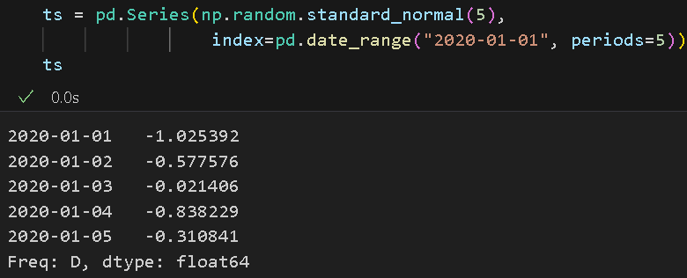
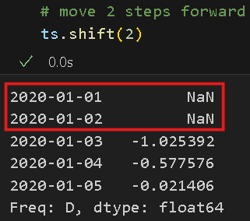
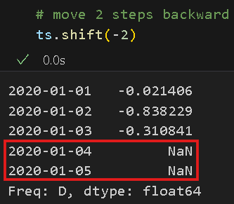
Shifting Data
Shifting – moving data forward and backward through time.
d. shift() – for naïve shifts for both Series and DataFrame leaving index unmodified.
Example: Move data 2 steps forward and backward, thus, creating NANs to replace those data

Slide 31
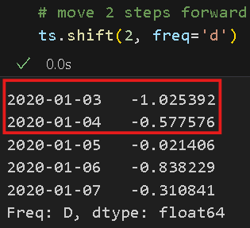
Shifting Data
Example: Moves data 2 steps forward and backward, without NaN values by passing a frequency
Take note of the timestamps and values

Slide 32
Resampling and frequency conversion

Slide 33
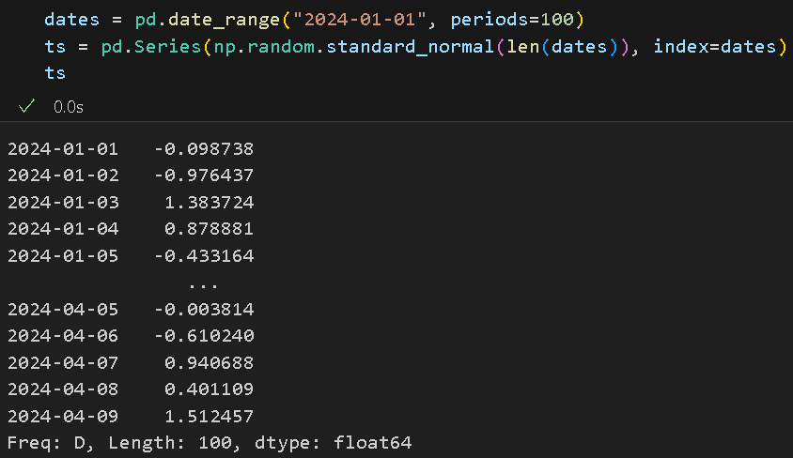
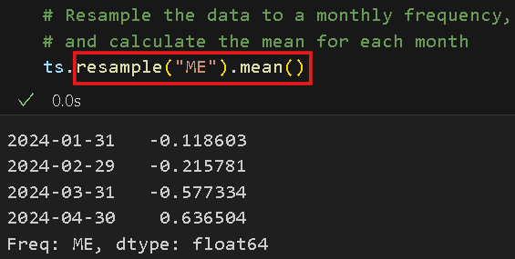
Resampling
Resampling – process of converting a time series from one frequency to another.
resample() – groups data like groupby and use with aggregate functions
- useful for all frequency conversion
Example:
Note: Refer to Table 11-5 of textbook for more resample method arguments.

Slide 34
Resampling: downsampling
Downsampling – resampling that aggregates higher frequency data to regular and lower frequency.
Bin edges – used to slice the time series into pieces to aggregate and are defined by the desired frequency.
Each interval are half-open
a data point can only belong to one interval
Use resample() – must consider the ff:
side of interval to close
Label of the aggregated bin: with start or end of the interval

Slide 35
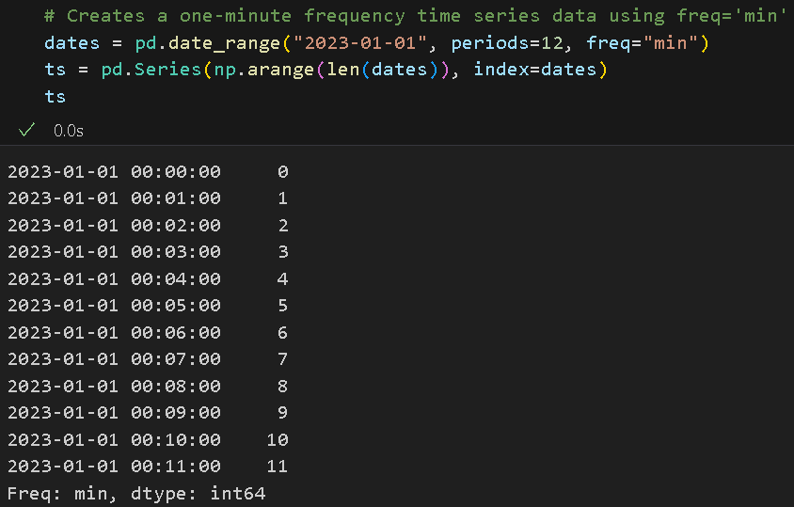
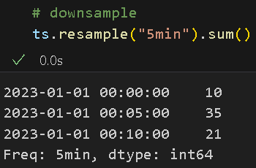
Resampling: downsampling
Example: Use resample() and with one-minute frequency data then downsample into 5-minute chunks by getting the sum of each group.
The 5-min frequency defines the bin edges in 5-min increments.
Left bin edge is inclusive, but the right bin edge is not:
1st bin = 00:00 – 04:00, 2nd bin = 05:00 – 09:00, 3rd bin = 10:00 – 15:00
SUM
1st bin
10
2nd bin
35
3rd bin
21

Slide 36
Resampling: downsampling
Example (continue):
LABELS:
Labels for each group are placed at the left end of the bin.
1st bin = 00:00:00 - 00:04:00
2nd bin = 00:05:00 - 00:09:00
3rd bin = 00:10:00 - 00:15:00
00:00:00
00:05:00
00:10:00

Slide 37
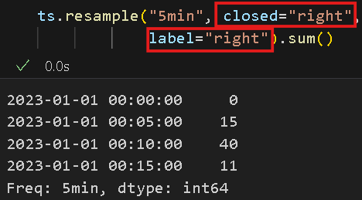
Resampling: downsampling
Example (continue):
labels = right – labels for each group are placed at the right end of the bin.
1st bin = 00:01:00 - 00:05:00
2nd bin = 00:06:00 - 00:10:00
3rd bin = 00:11:00 - 00:15:00
closed=right will include the data points up to and including the right end of the bin.
LABELS:
SUM
00:05:00
15
00:10:00
40
00:15:00
11

Slide 38
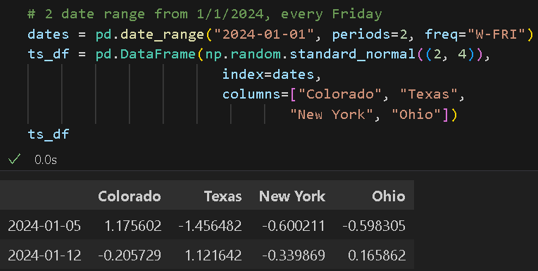
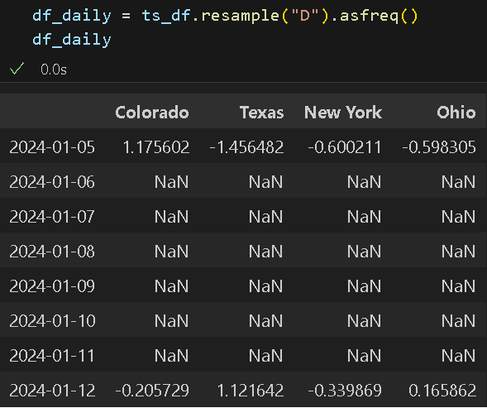
Resampling: upsampling
Upsampling – resampling that converts lower frequency data to a higher frequency, without aggregation.
Use resample() then asfreq() to convert data to higher frequency without any aggregation.
Example: Upsample from weekly to daily
This will fill timestamps that were not original there with NaN values

Slide 39

Resampling: upsampling and interpolation
Example (continue): Upsample from weekly to daily (yield Nan values on non-Fridays)
Solution for NaN values: Interpolation; forward fill (use available value from previous row)in this example

Slide 40
Moving window functions

Slide 41


Moving window functions
Moving window functions – statistical and other functions
– used for array transformation evaluated over a sliding window or exponentially decaying weights.
- Useful for smoothing noisy data or data with gaps.
Example: stock
data

Slide 42


Moving window functions
a. Rolling operator – behaves similarly to resample and groupby.
Window argument – use for specifying the number of periods.
Example: stock data applied with rolling operator and with a 250-sliding window.
This computes the 250-day moving average of Apple’s stock price; with a 250 period, the first 250 timestamps will have NaN values.

Slide 43


Moving window functions
Example: Plotting the stock price data and its 250-day moving average
The moving average(orange) is a lot smoother compared to the original data(blue).

Slide 44

Moving window functions
b. pct_change() – calculates the percentage change between the current and prior data in the series.
Example: stock data applied with rolling operator and a 250-sliding window, then compute the std deviation for at least 10 periods of the percentage change.
- passing min_period to the rolling() method minimizes the Nan values, from 250 to 10 (in this example)
This calculates the daily percentage return; the 250-day rolling window/moving average of Apple’s stock price; and the standard deviation of the returns within each rolling window.

Slide 45


Moving window functions
Example: Plotting the stock daily returns’ standard deviation with a 250-day rolling window

Slide 46

Moving window functions
c. expanding() – computes an expanding window mean
Expanding mean – starts the time window from the same point as the rolling window and increases the size of the window until all the data points are included.
Example: expanding window mean of stock’s daily returns’ standard deviation from earlier

Slide 47


Moving window functions
Example: Plotting the stock daily returns’ standard deviation with a 250-day rolling window(blue) and its expanding mean(orange)

Slide 48



Moving window functions
Example: Computing and plotting the 60-rolling mean of all the stock prices in a DataFrame.

Slide 49

Moving window functions
d. ewm() – operator for exponentially weighted moving average.
exponentially weighted moving average – places more weight on the more recent data and can adapt faster to changes.
Example: exponentially weighted moving average of Apple stock price with span and window size of 30.

Slide 50


Moving window functions
Example: Plotting Apple daily stock price, Simple Moving Average, and EW Moving Average

Slide 51
References
reference
McKinney, W. (2022). Python for Data Analysis: Data Wrangling with Pandas, Numpy, and IPython. O’Reilly. (ISBN: 1-0981-0402-1)
McKinney, W. (2022). Python for Data Analysis: Data Wrangling with Pandas, Numpy, and IPython. O’Reilly. (ISBN: 1-0981-0402-1)

Slide 52

Thank you!

